Slide 1

EXCEL- RETAIL PROJECT
Diagnosing Declining Sales and Revenue Leakage Analysis
Role: Data Analyst – Sales Intelligence Division
Tools Used: Excel (Power Pivot, Power Query, DAX, Pivot Tables)
- By Adeniyi Adeyemi
2018-2022 Report

Slide 2
Table of Contents
Business Overview
Objectives
Data overview & Approach
Key Performance Indicators (KPIs)
Sales Performance Overview (Yearly)
Quarterly Revenue Analysis
Monthly Seasonality Analysis
Discount Pattern & Campaign Impact
Product Performance Analysis
Key Drivers Of Sales Decline
Expected Business Impact & Next Steps
Appendix – Dashboards Snapshot

Slide 3
Business Overview
A growing e-commerce retail company operating across Europe. Over the past few years, the management has observed fluctuating revenue trends and a steady decline in overall sales performance.
Therefore, the Executive leadership requires clarity on root causes and corrective actions

Slide 4

Objectives
To use historical sales data to:
Identify when and where sales began to decline
Detect sources of revenue &minimize leakage
Recommend data-driven strategies to restore growth and profitability

Slide 5
Dataset Overview
Period: 2018–2022
Transactions across European markets
Key fields: Product, Category, Country, Quantity, Discount %, Net Revenue
Analytical Approach
Built a Power Pivot data model
Created DAX measures for Net Revenue, Growth, Seasonality
Developed an Executive-level Pivot dashboard

Slide 6
Key Performance Indicators (KPIs)
Net Revenue
£1,019,227
YOY Revenue Growth%
23.68%
Total Orders
9,207
Average Order Value
£111
Peak Month Revenue
£92,543
Low Month Revenue
£78,404

Slide 7
Sales Performance Overview (Yearly)
Key Findings:
Revenue peaked in 2021 (£220k)
Decline observed in 2022 (£195k)
Growth trend reversed after steady improvement
Insights
➡ The sales decline is recent and structural, not random
➡ Signals changes in pricing, campaign effectiveness, or product strategy

Slide 8
Quarterly Revenue Analysis
Observations:
Q2 and Q3 consistently outperform other quarters
Q1 and Q4 show recurring underperformance
Q4 weakness persists even during traditionally strong retail periods
Insights
➡ Seasonal opportunities are not fully capitalized
➡ Campaign timing and execution need optimization

Slide 9
Monthly Seasonality Analysis
Revenue Patterns
Peak Month: May (£92,543)
Lowest Month: November (£78,404)
Noticeable Volatility Across Months
Insights
➡ Revenue Is Highly Seasonal
➡ Targeted Promotions Do Not Sufficiently Support Weak Months

Slide 10
Discount Patterns & Campaign Impact
Key Observations:
Average discount remains stable at ~15% year-round
Higher discounts do not consistently drive higher revenue
Some low-discount months still record revenue declines
Insights
➡ Blanket discounting causes revenue leakage
➡ Discount strategy lacks precision and ROI measurement

Slide 11
Product Performance Analysis
Top Revenue Contributors
Toy Car, Wireless Mouse, Mug, Bag, Lamp
High volume and strong revenue contribution
Underperforming Products
Gift Wrap, Notebook, Pen Set, Clock, Candle Set
Low revenue impact despite ongoing sales
Insights
➡ Product portfolio inefficiencies dilute margins
➡ Resources are spread across low-value products

Slide 12
Key Drivers Of Sales Decline
Identified Root Causes
Ineffective, blanket discounting
Weak campaign targeting
Underperforming product lines
Poor alignment between seasonality and promotions

Slide 13
Expected Business Impact & Next Steps
Expected Impacts
Reduced revenue leakage
Improved net revenue retention
More predictable seasonal performance
Stronger profitability without deeper discounting
Next Steps
Implement recommended strategies
Monitor KPIs monthly
Refine campaigns using data-driven feedback loops

Slide 14
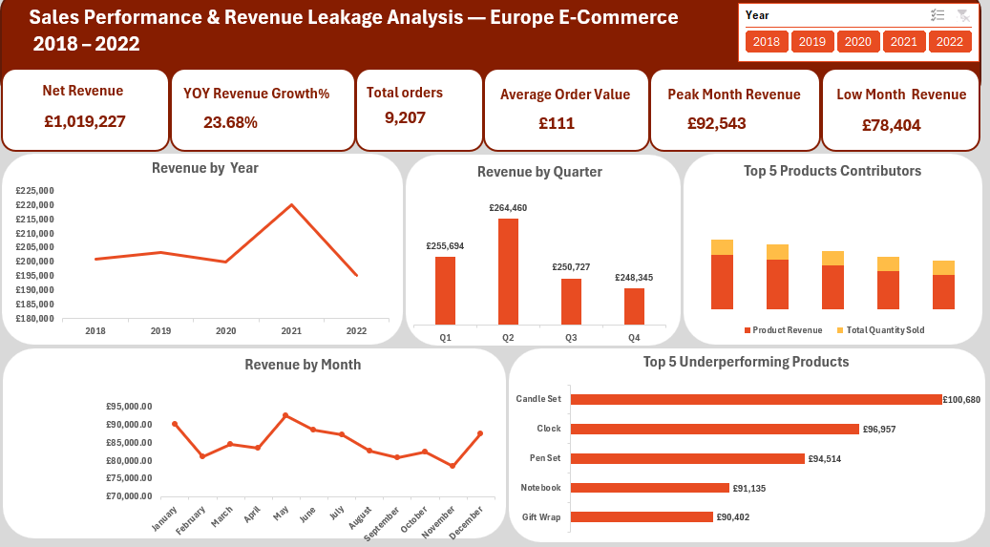

Slide 15
